Slide 1




Slide 15
Compose camp
2022
Navigation and app architecture

Slide 16
Compose camp
2022
Navigation and app architecture

Slide 17
Compose camp
2022
Navigation and app architecture

Slide 18

Compose camp
2022
Presented by
Navigation and app architecture

Slide 19
Compose camp
2022
Presented by
Navigation and app architecture

Slide 20
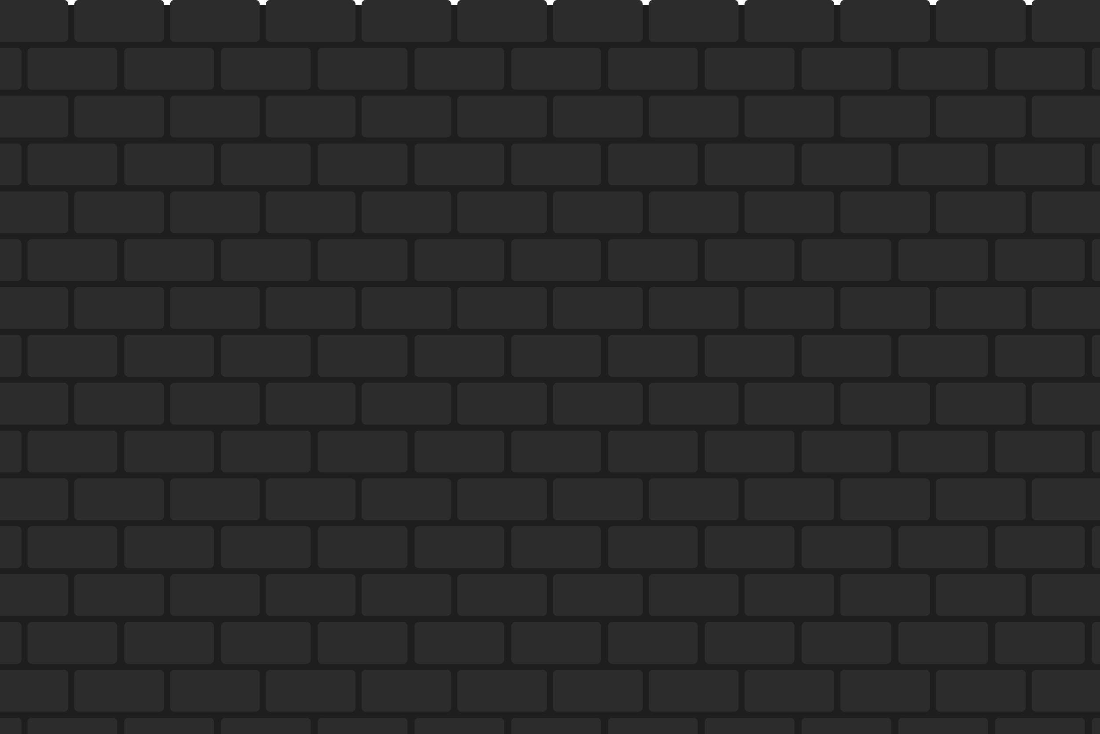
In this course, you’ll learn
Presented by

Slide 21

In this course, you’ll learn
Presented by

Slide 22
In this course, you’ll learn
Presented by

Slide 23
In this course, you’ll learn

Slide 24

In this course, you’ll learn
And also learn to build your very own working android
application from scratch.

Slide 26
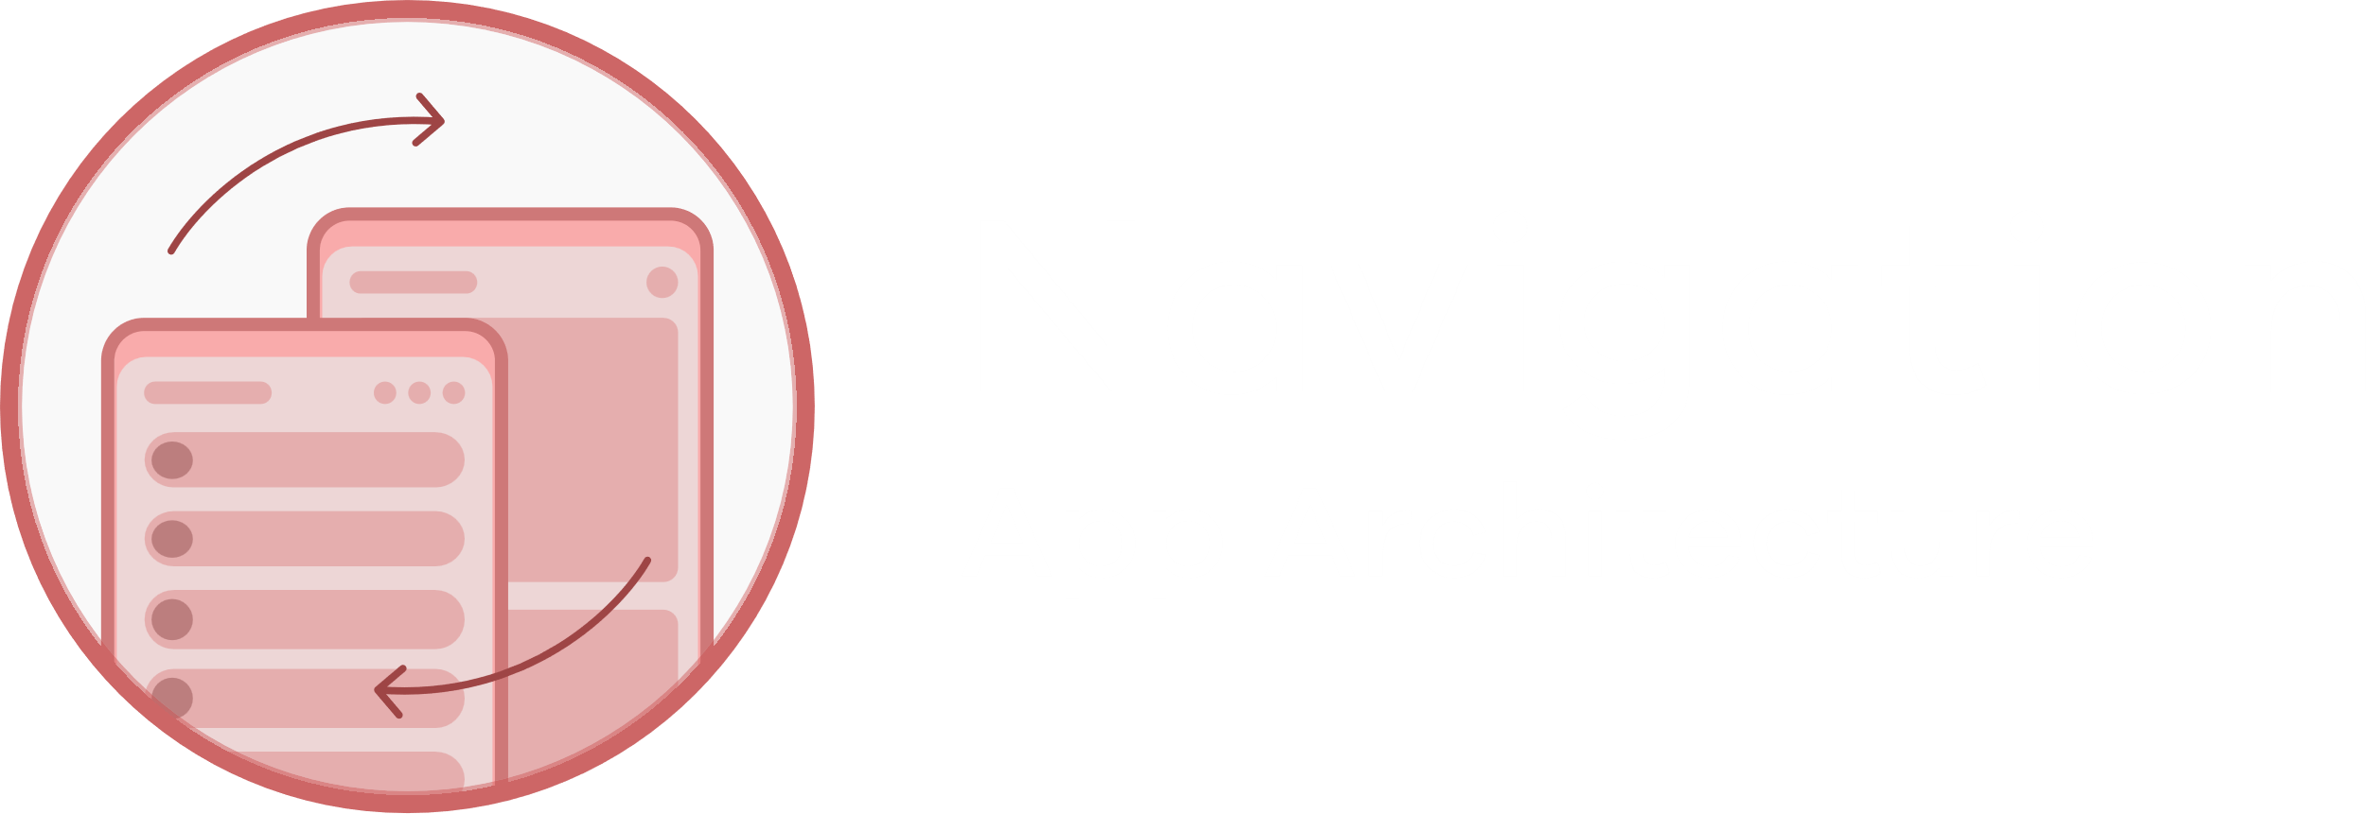

Welcome to
Day 2
Develop your app’s architecture
& create user friendly navigation
Great
Digital
Rewards

Slide 27
Welcome to
Day 2
Develop your app’s architecture
& create user friendly navigation
Great
Digital
Rewards

Slide 28
Welcome to
Day 2
Develop your app’s architecture
& create user friendly navigation
Great
Digital
Rewards

Slide 29


Welcome to
Day 2
Develop your app’s architecture
& create user friendly navigation
Great
Digital
Rewards

Slide 30
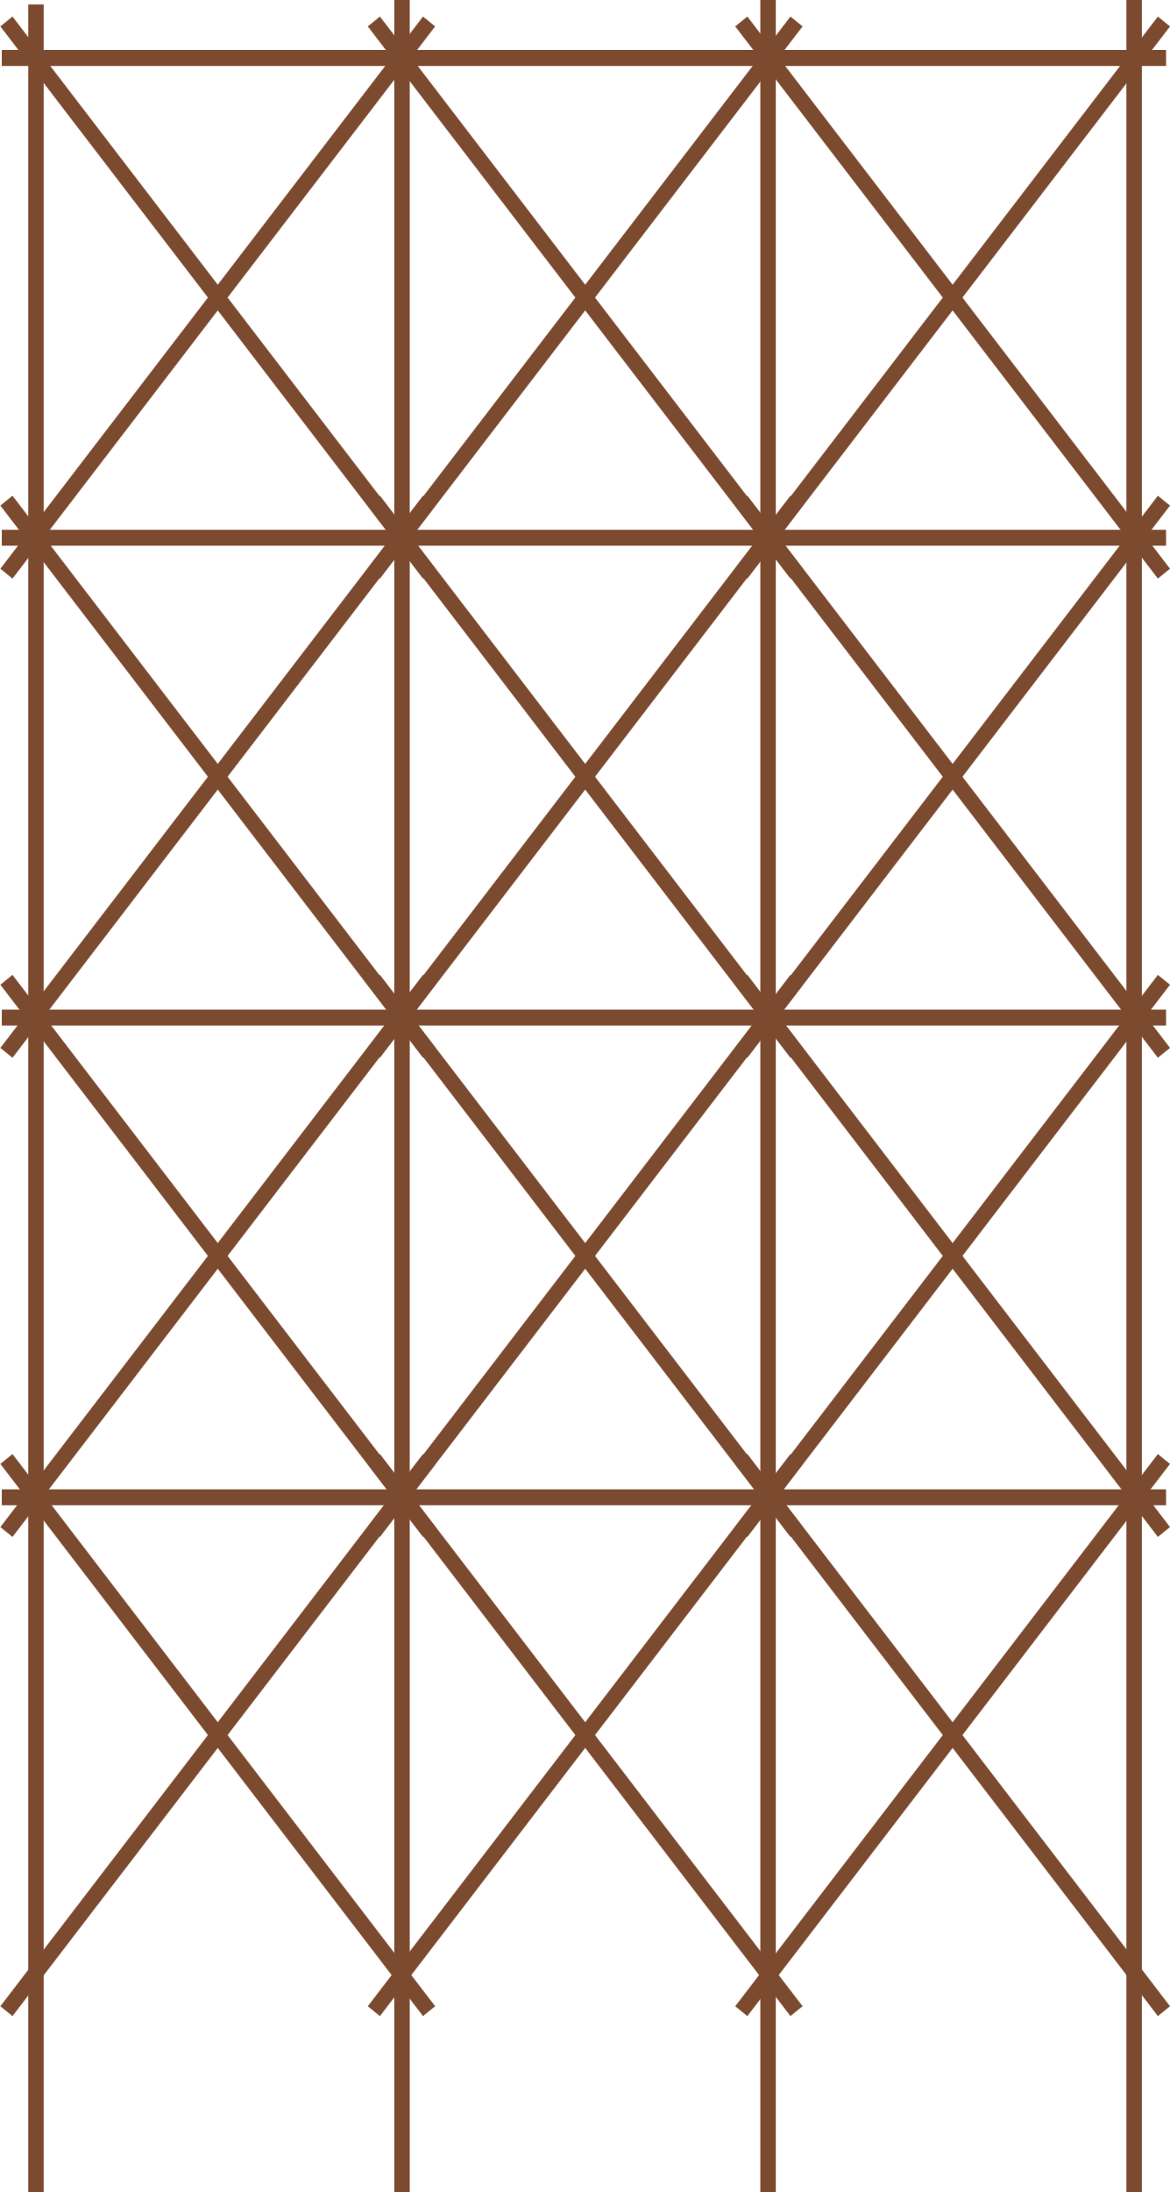
Unit 04
App
Architecture

Slide 31

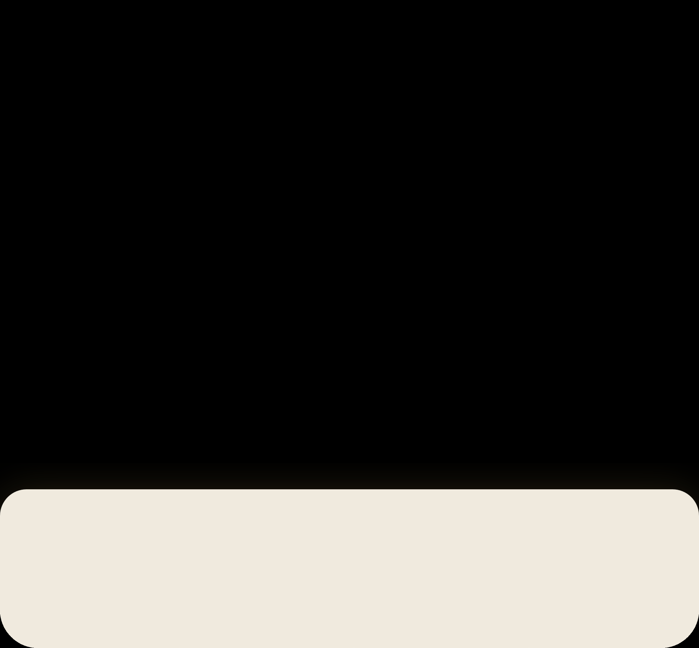
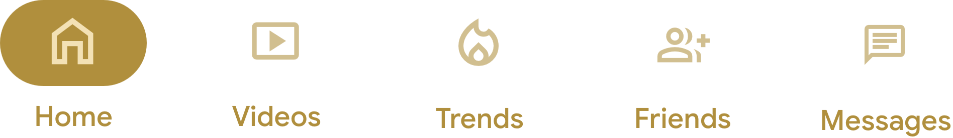
Unit 04
App
Architecture

Slide 32
Unit 04
App
Architecture

Slide 33
Unit 04
App
Architecture

Slide 34
Unit 04
App
Architecture

Slide 35
Unit 04
App
Architecture

Slide 36
Unit 04
App
Architecture

Slide 37
Unit 04
App
Architecture

Slide 38
Architecture Components
Unit 04
Unit 04
App
Architecture

Slide 39
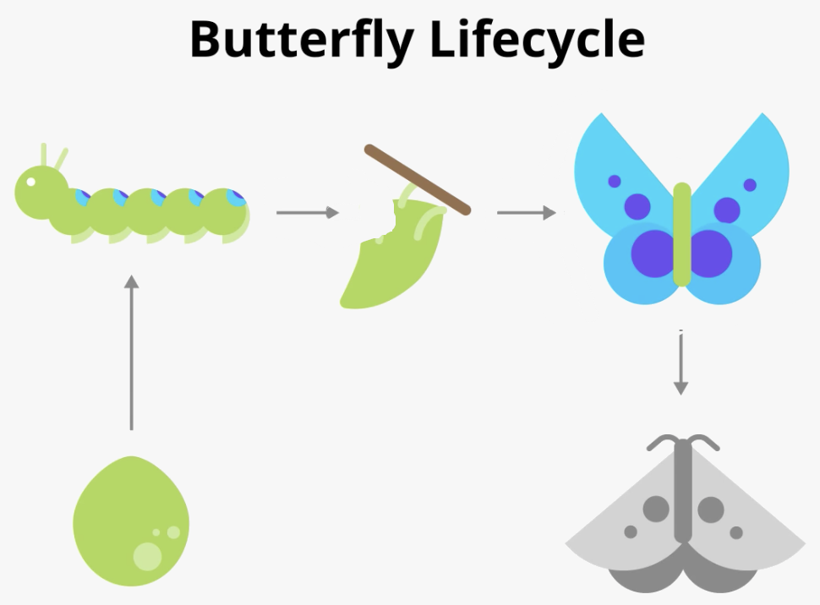
Architecture Components
Unit 04
Explore the lifecycle methods
Every activity has what is known as a lifecycle. This term is an allusion to plant and animal life cycles, like the lifecycle of a butterfly—the different states of the butterfly show its growth from egg to caterpillar to pupa to butterfly to death. Similarly, the activity lifecycle consists of the different states that an activity can go through.
Unit 04
App
Architecture

Slide 40
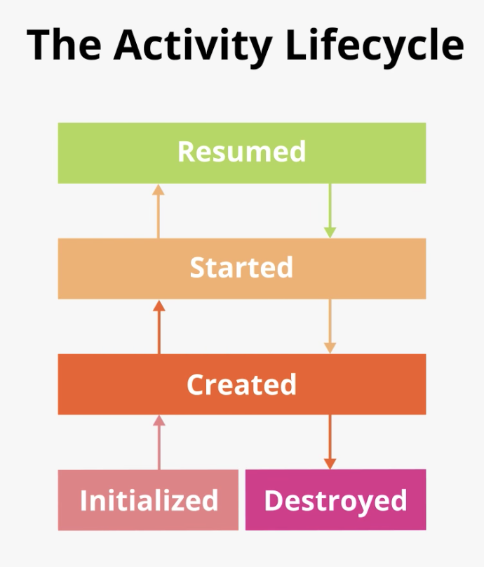
Architecture Components
Unit 04
The following diagram shows all the activity lifecycle states. As their names indicate, these states represent the status of the activity. Notice that, unlike the butterfly lifecycle, an activity can go back and forth between states throughout the lifecycle, instead of only moving in a single direction.

Slide 41
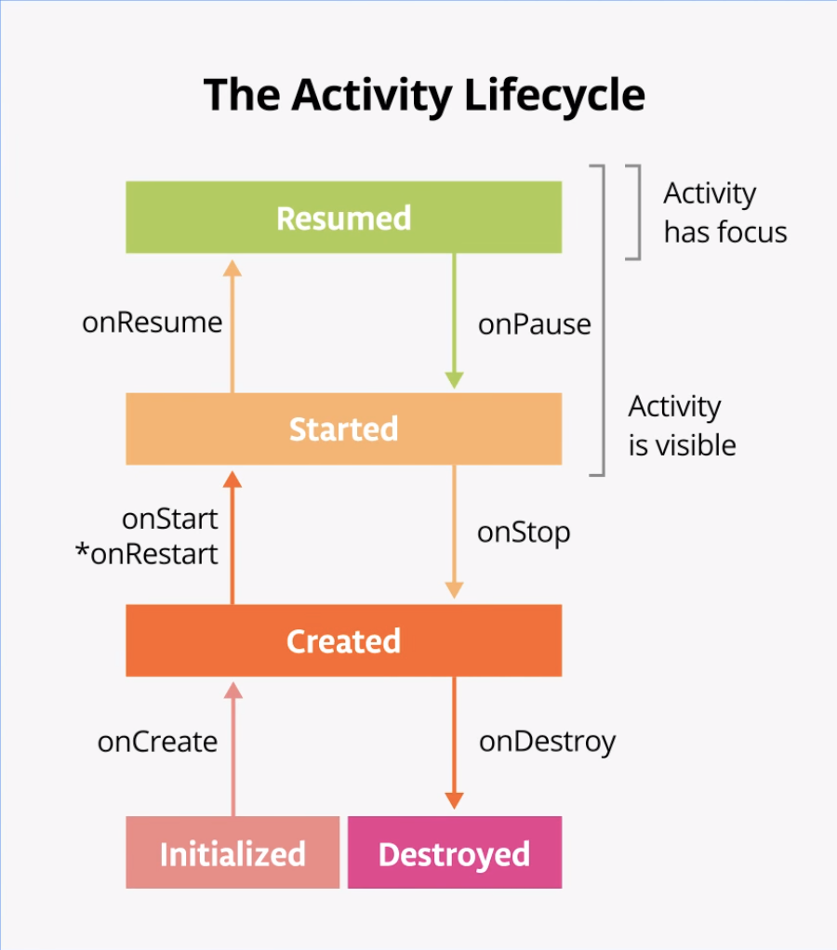
Architecture Components
Unit 04
Often, you want to change some behaviour, or run some code, when the activity lifecycle state changes. Therefore, the Activity class itself, and any subclasses Activity such as ComponentActivity, implement a set of lifecycle callback methods. Android invokes these callbacks when the activity moves from one state to another, and you can override those methods in your own activities to perform tasks in response to those lifecycle state changes. The following diagram shows the lifecycle states along with the available overridable callbacks.

Slide 42
Architecture Components
Unit 04
Logging
The Log class writes messages to the Logcat. The Logcat is the console for logging messages. Messages from Android about your app appear here, including the messages you explicitly send to the log with the Log.d() method or other Log class methods.

Slide 43
Architecture Components
Unit 04
There are three important aspects of the Log instruction:
The priority of the log message, that is, how important the message is. In this case, the Log.v() logs verbose messages. Log.d() method writes a debug message. Other methods in the Log class include Log.i() for informational messages, Log.w() for warnings, and Log.e() for error messages.
The log tag (the first parameter) The tag is a string that lets you more easily find your log messages in the Logcat. The tag is typically the name of the class.
The actual log message, called msg (the second parameter), is a short string.

Slide 44

Architecture Components
Unit 04
Explore lifecycle use cases
Opening and closing the activity
Notice in Logcat that onPause() and onStop() are called in that order.
In this case, using the Back button causes the activity (and the app) to be removed from the screen and moved to the back of the activity stack.
Navigating away from and back to the activity
Notice that the onPause() and onStop() methods are called. When onPause() is called, the app no longer has focus. After onStop(), the app is no longer visible on screen.
Notice in Logcat that the activity restarts with onRestart() and onStart() and then resumes with onResume().
Partially hide the activity
Examine Logcat and note that only onPause() was called.
In this use case, onStop() is not called because the activity is still partially visible. But the activity does not have user focus, and the user can't interact with it
The onResume() method is called when the activity gains focus, and onPause() is called when the activity loses focus.
Let’s Talk
Business

Slide 45
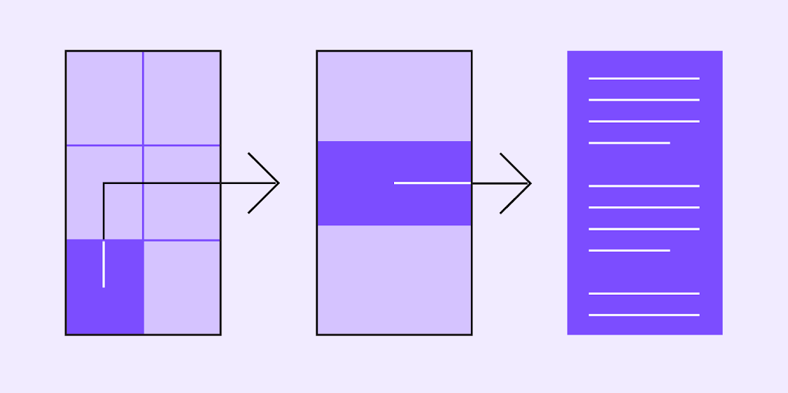

Navigation
Navigation enables users to move through an app.
Adapt for different screen sizes
Unit 04
Let’s Talk
Business

Slide 46
Architecture Components
Unit 04
Explore configuration changes
A configuration change occurs when the state of the device changes so radically that the easiest way for the system to resolve the change is to completely shut down and rebuild the activity.

Slide 47
Architecture Components
Unit 04
Lifecycle of a composable
The UI of your app is initially built from running composable functions in a process called Composition.
When the state of your app changes, a recomposition is scheduled. Recomposition is when Compose reexecutes the composable functions whose state might have changed and creates an updated UI. The Composition is updated to reflect these changes.
Composable functions have their own lifecycle that is independent of the Activity lifecycle.
In order for Compose to track and trigger a recomposition, it needs to know when state has changed. To indicate to Compose that it should track an object's state, the object needs to be of type State or MutableState. The State type is immutable and can only be read. A MutableState type is mutable and allows reads and writes.

Slide 48
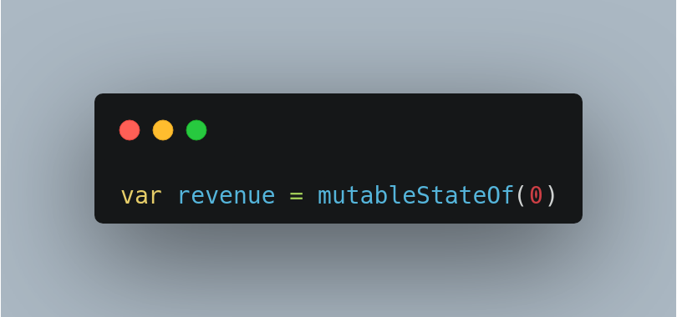
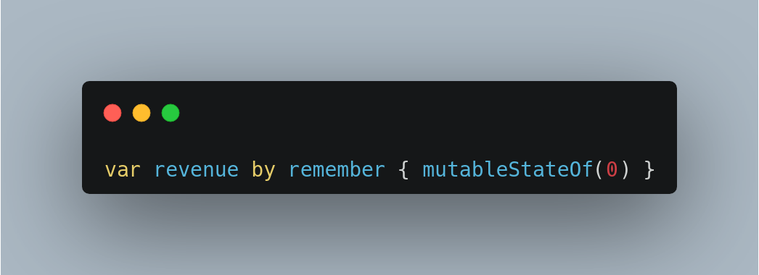
Architecture Components
Unit 04
To instruct Compose to retain and reuse its value during recompositions, you need to declare it with the remember API.

Slide 49
Architecture Components
Unit 04
Use rememberSaveable to save values across configuration changes
You use the rememberSaveable function to save values that you need if Android OS destroys and recreates the activity.
To save values during recompositions, you need to use remember. Use rememberSaveable to save values during recompositions AND configuration changes.

Slide 50
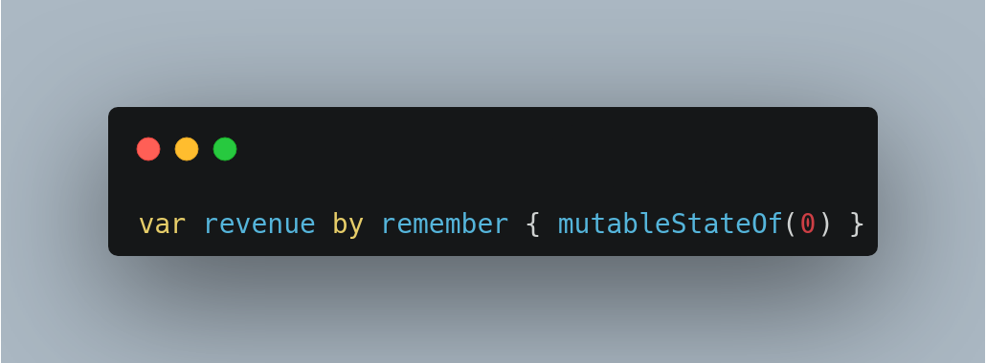
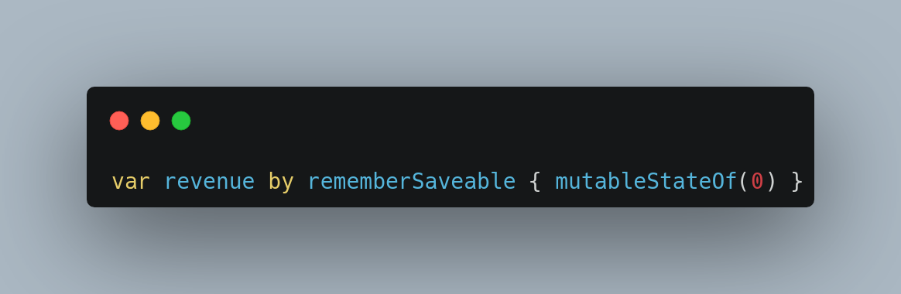
Architecture Components
Unit 04

Slide 51
Architecture Components
Unit 04
Intro to App architecture
Separation of concerns
Drive UI from data models
Single source of truth
Unidirectional Data Flow
Well architected apps
Easier to:
Test
Make Robust
Expand
Team Develop
Recommended app architecture
UI layer: a layer that displays the app data on the screen but is independent of the data.
Data layer: a layer that stores, retrieves, and exposes the app data.
You can add another layer, called the domain layer, to simplify and reuse the interactions between the UI and data layers. This layer is optional and beyond the scope of this course.

Slide 52
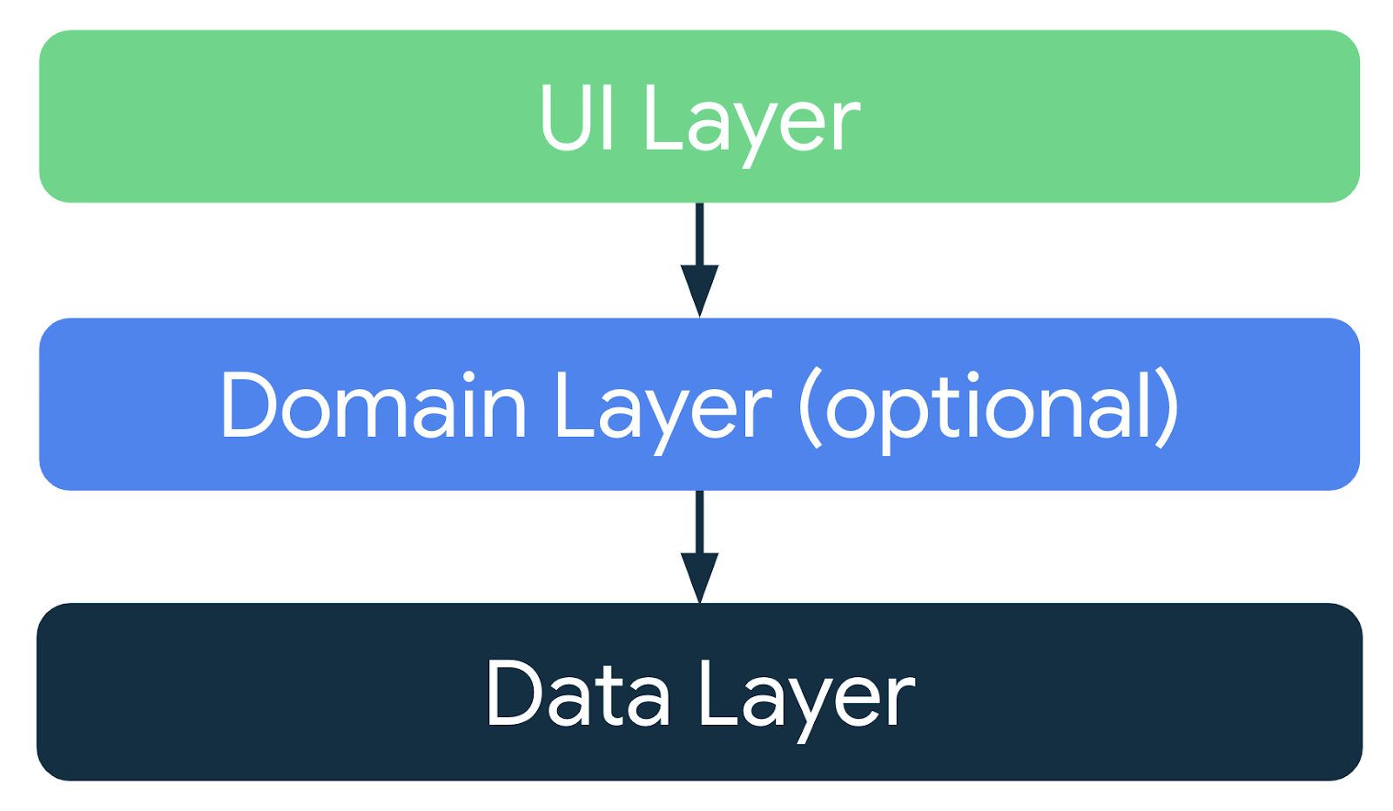
Architecture Components
Unit 04

Slide 53
Architecture Components
Unit 04
UI layer
The role of the UI layer, or presentation layer, is to display the application data on the screen. Whenever the data changes due to a user interaction, such as pressing a button, the UI should update to reflect the changes.
The UI layer is made up of the following components:
UI elements: components that render the data on the screen. You build these elements using Jetpack Compose.
State holders: components that hold the data, expose it to the UI, and handle the app logic. An example state holder is ViewModel.

Slide 54
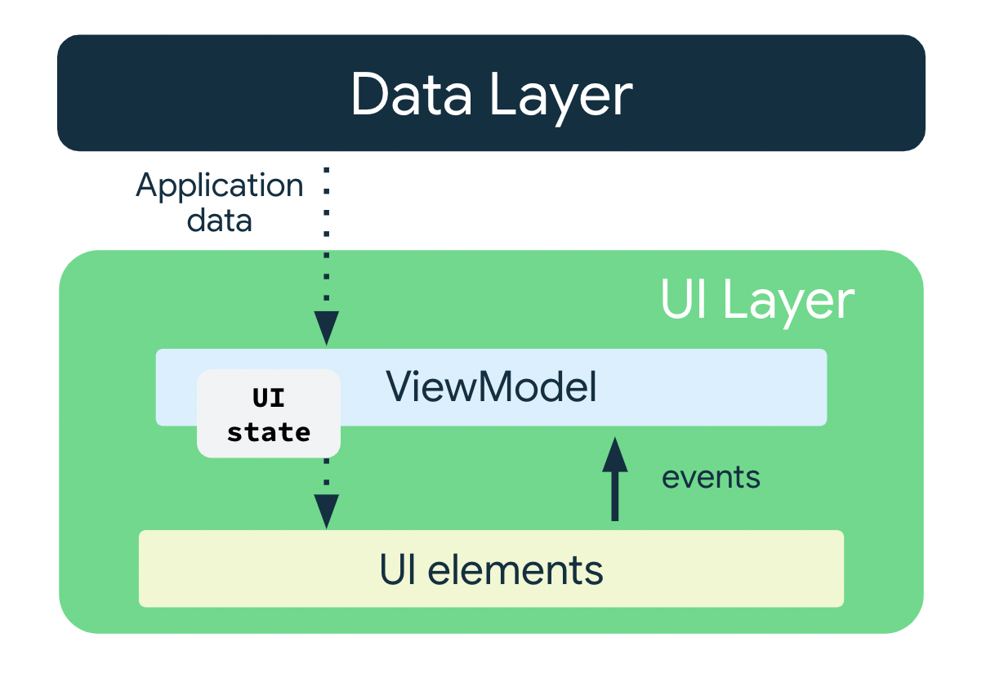
Architecture Components
Unit 04

Slide 55
Architecture Components
Unit 04
ViewModel
The ViewModel component holds and exposes the state that the UI consumes. The UI state is application data transformed by ViewModel. ViewModel lets your app follow the architecture principle of driving the UI from the model.
ViewModel stores the app-related data that isn't destroyed when the activity is destroyed and recreated by the Android framework. Unlike the activity instance, ViewModel objects are not destroyed. The app automatically retains ViewModel objects during configuration changes so that the data they hold is immediately available after the recomposition.

Slide 56
Write unit tests for ViewModel
Unit 04
Test strategy
A good test strategy revolves around covering different paths and boundaries of your code. At a very basic level, you can categorise the tests in three scenarios: success path, error path, and boundary case.
Success path
The success path tests - also known as happy path tests, focus on testing the functionality for a positive flow. A positive flow is a flow that has no exception or error conditions. Compared to the error path and boundary case scenarios, it is easy to create an exhaustive list of scenarios for success paths, since they focus on intended behaviour for your app.
Error path
The error path tests focus on testing the functionality for a negative flow–that is, to check how the app responds to error conditions or invalid user input. It is quite challenging to determine all the possible error flows because there are lots of possible outcomes when intended behaviour is not achieved.
Boundary case
A boundary case focuses on testing boundary conditions in the app.

Slide 57
Write unit tests for ViewModel
Unit 04
Create tests
A good unit test typically has following four properties:
Focused
It should focus on testing a unit, such as a piece of code. This piece of code is often a class or a method. The test should be narrow and focus on validating the correctness of individual pieces of code, rather than multiple pieces of code at the same time.
Understandable
It should be simple and easy to understand when you read the code. At a glance, a developer should be able to immediately understand the intention behind the test.
Deterministic
It should consistently pass or fail. When you run the tests any number of times, without making any code changes, the test should yield the same result. The test shouldn't be flaky, with a failure in one instance and a pass in another instance despite no modification to the code.
Self-contained
It does not require any human interaction or setup and runs in isolation.

Slide 58
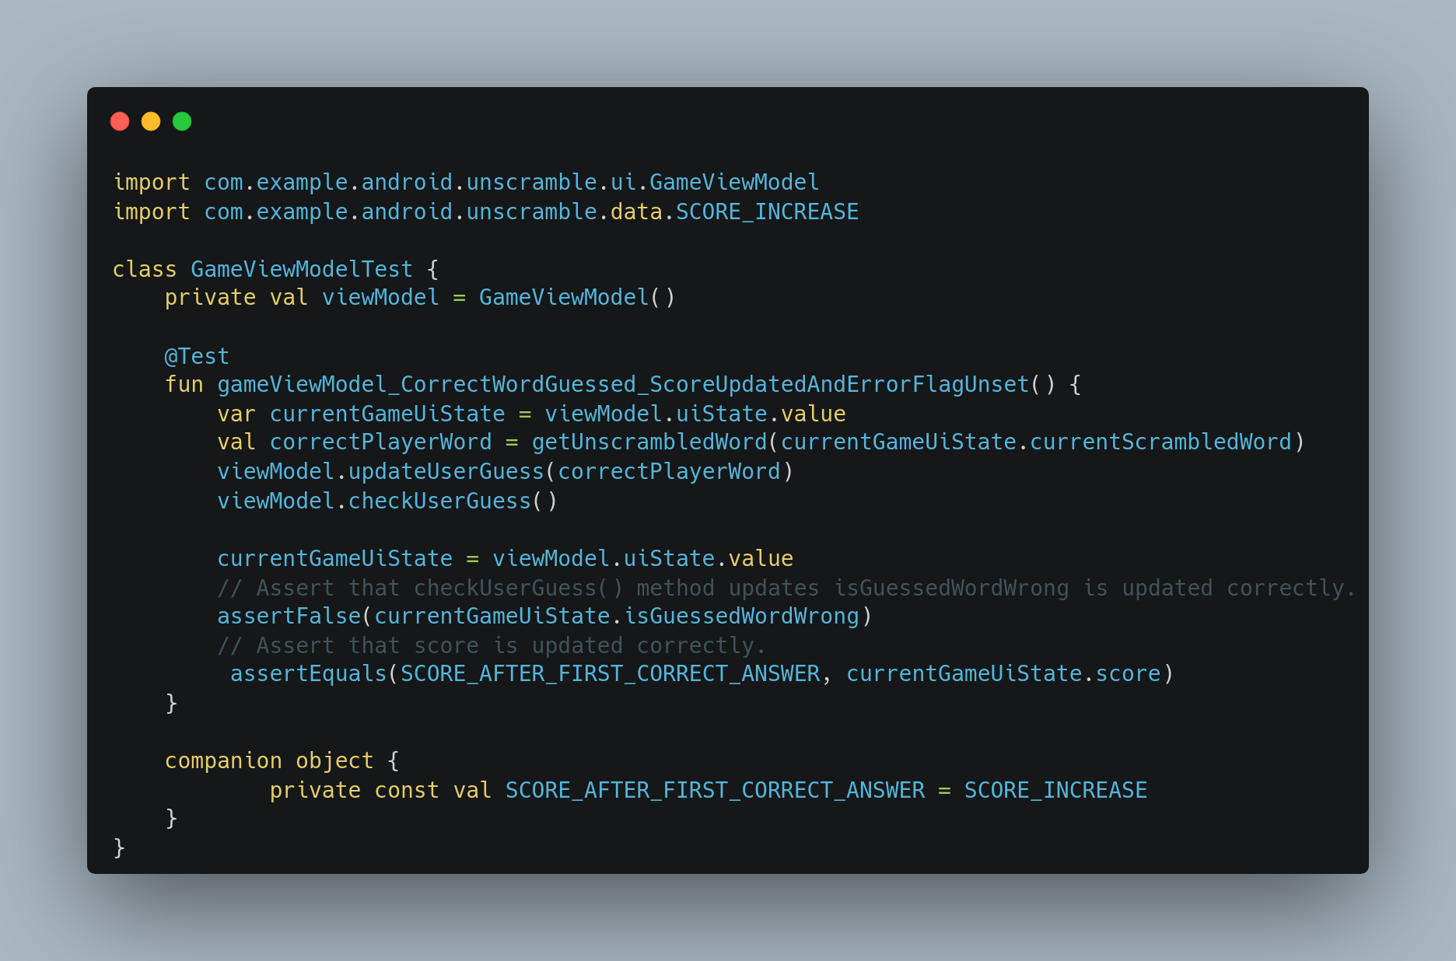
Write unit tests for ViewModel
Unit 04

Slide 59
Write unit tests for ViewModel
Unit 04
Note: The code above uses the thingUnderTest_TriggerOfTest_ResultOfTest format to name the test function name:
thingUnderTest = gameViewModel
TriggerOfTest = CorrectWordGuessed
ResultOfTest = ScoreUpdatedAndErrorFlagUnset

Slide 60
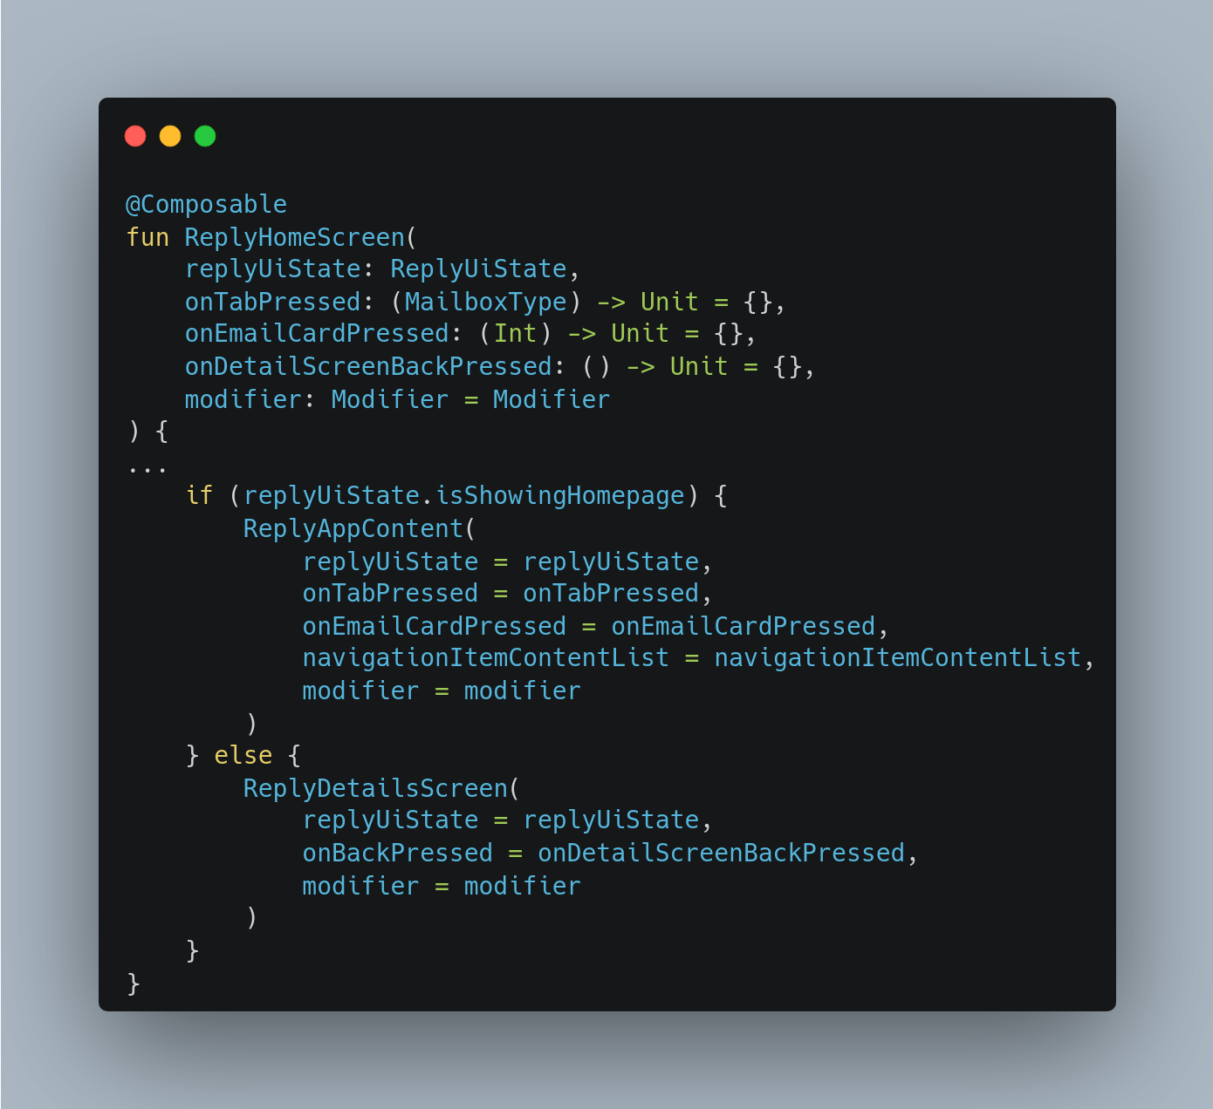
Adapt for different screen sizes
Unit 04
Change screens with state changes
In Compose, screens are recomposed when a state change occurs. You can change screens using simple conditionals to respond to changes in states.

Slide 61
Adapt for different screen sizes
Unit 04
Design for large screens
When designing for large screens, such as tablets and foldables, you have to consider user ergonomics and the proximity of the users' fingers to the screen. For large screens, having critical interactive elements in the middle of the screen can make them hard to reach.

Slide 62
Adapt for different screen sizes
Unit 04
Design for large screens
When designing for large screens, such as tablets and foldables, you have to consider user ergonomics and the proximity of the users' fingers to the screen. For large screens, having critical interactive elements in the middle of the screen can make them hard to reach.

Slide 63
Adapt for different screen sizes
Unit 04
Design for large screens
When designing for large screens, such as tablets and foldables, you have to consider user ergonomics and the proximity of the users' fingers to the screen. For large screens, having critical interactive elements in the middle of the screen can make them hard to reach.

Slide 64
Adapt for different screen sizes
Unit 04
What are breakpoints?
To create an adaptive app, you need the layout to change based on screen size. The measurement point where a layout changes is known as a breakpoint. Material Design created an opinionated breakpoint range that covers most Android screens.

Slide 65
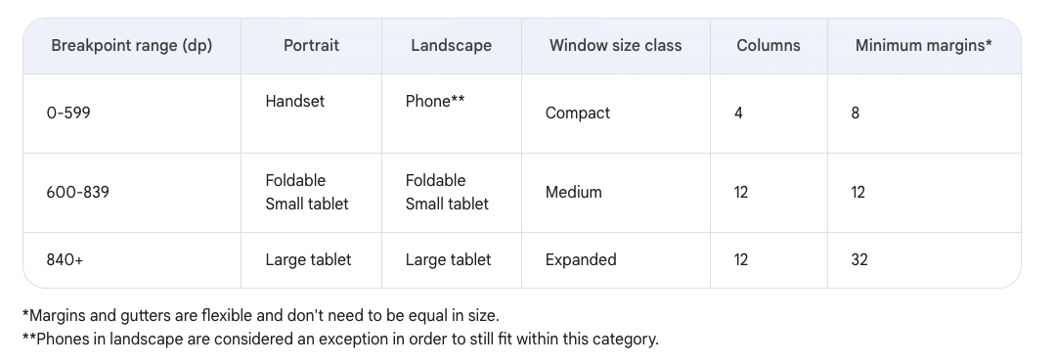
Adapt for different screen sizes
Unit 04

Slide 66
Adapt for different screen sizes
Unit 04
Use Window Size Classes
The WindowSizeClass API introduced for Compose makes the implementation of Material Design breakpoints simpler.
Window Size Classes introduces three categories of sizes: Compact, Medium, and Expanded, for both width and height.

Slide 67
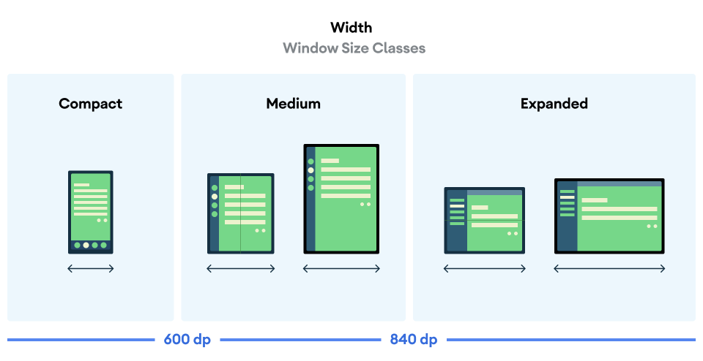
Adapt for different screen sizes
Unit 04

Slide 68
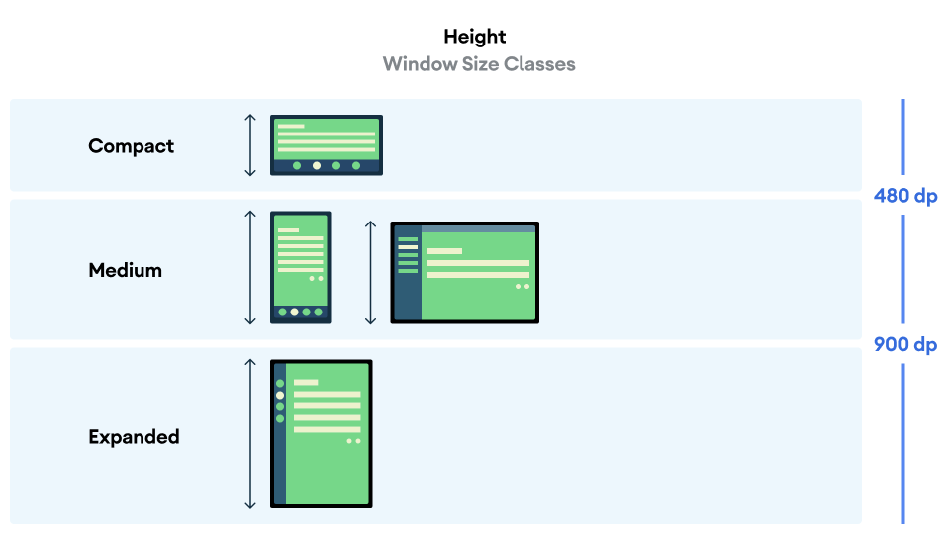
Adapt for different screen sizes
Unit 04

Slide 69
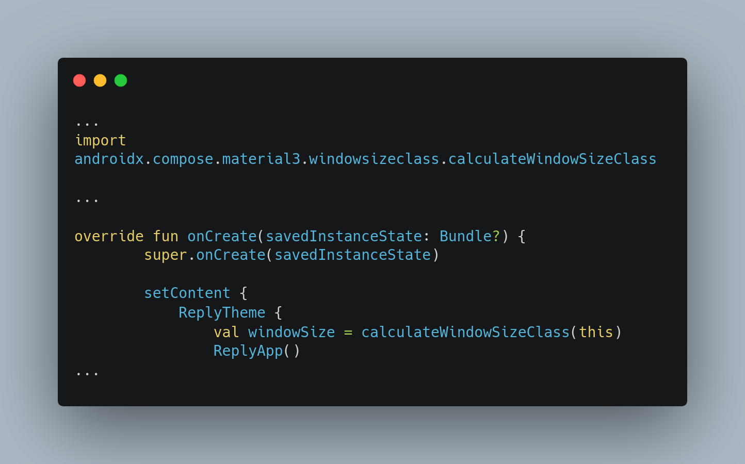
Adapt for different screen sizes
Unit 04

Slide 70
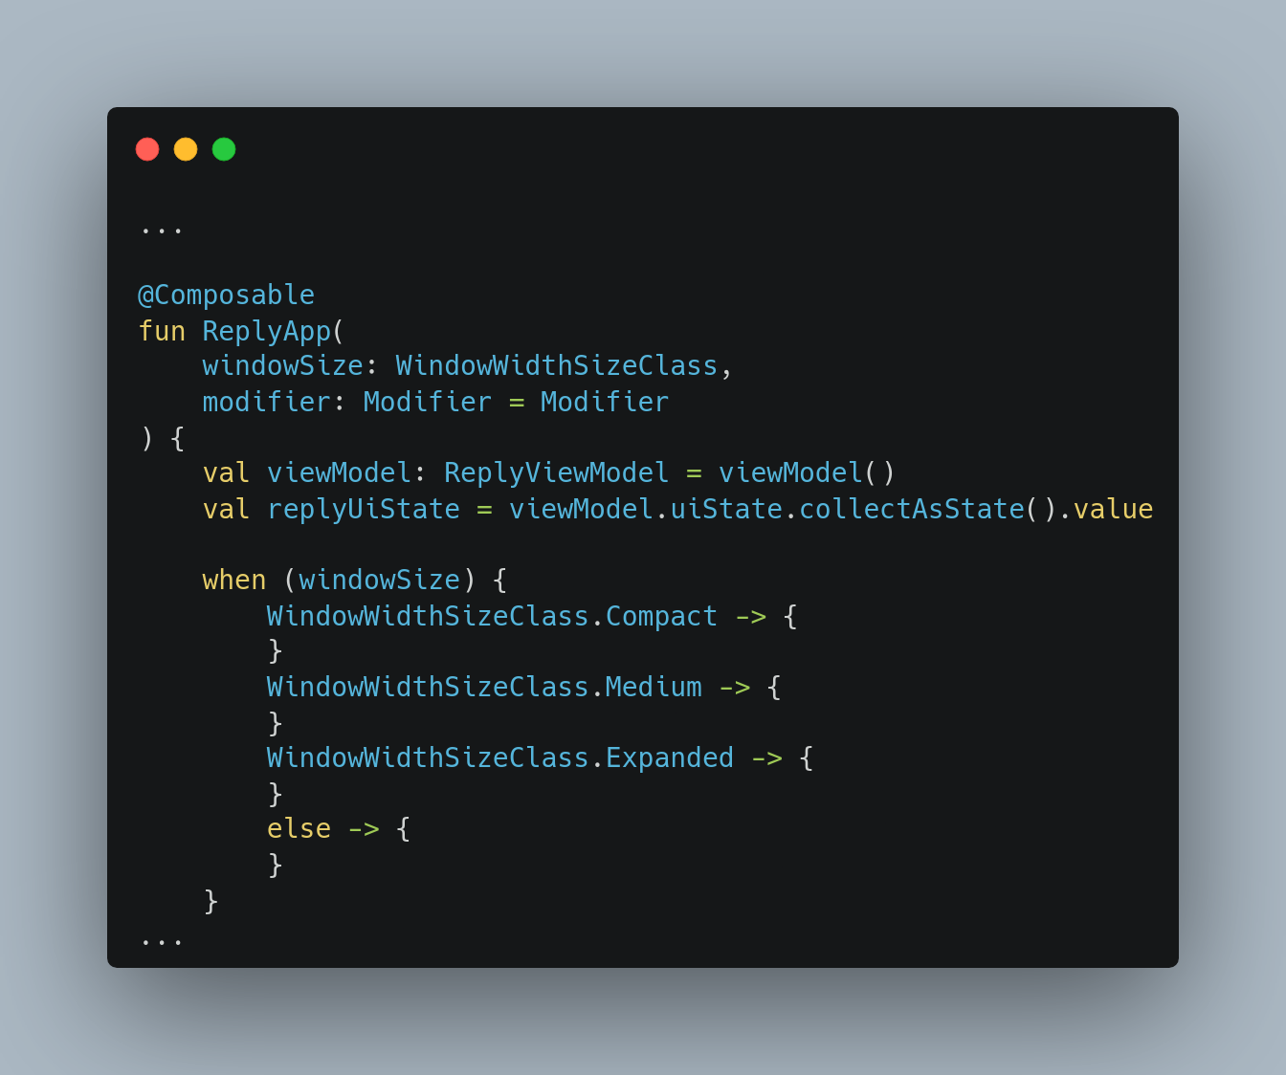
Navigation
Navigation enables users to move through an app.
Adapt for different screen sizes
Unit 04

Slide 71
Navigation
Unit 04
Navigation enables users to move through an app.
Let’s Navigate to
The Figma Prototype window
To understand… Navigation

Slide 72
Navigation
Unit 04
Types of navigation
Navigation is the act of moving between screens of an app to complete tasks. It’s enabled through several means: dedicated navigation components, embedding navigation behavior into content, and platform affordances.
Navigational directions
Based on your app’s information architecture, a user can move in one of three navigational directions:
Lateral navigation refers to moving between screens at the same level of hierarchy. An app’s primary navigation component should provide access to all destinations at the top level of its hierarchy.
Forward navigation refers to moving between screens at consecutive levels of hierarchy, steps in a flow, or across an app. Forward navigation embeds navigation behavior into containers (such as cards, lists, or images), buttons, links, or by using search.
Reverse navigation refers to moving backwards through screens either chronologically (within one app or across different apps) or hierarchically (within an app). Platform conventions determine the exact behavior of reverse navigation within an app.
Let’s Navigate to
The Figma Prototype window
To understand… Navigation

Slide 73
Navigation
Unit 04
Let’s Navigate to
the Figma Prototype window
to understand… Navigation

Slide 74
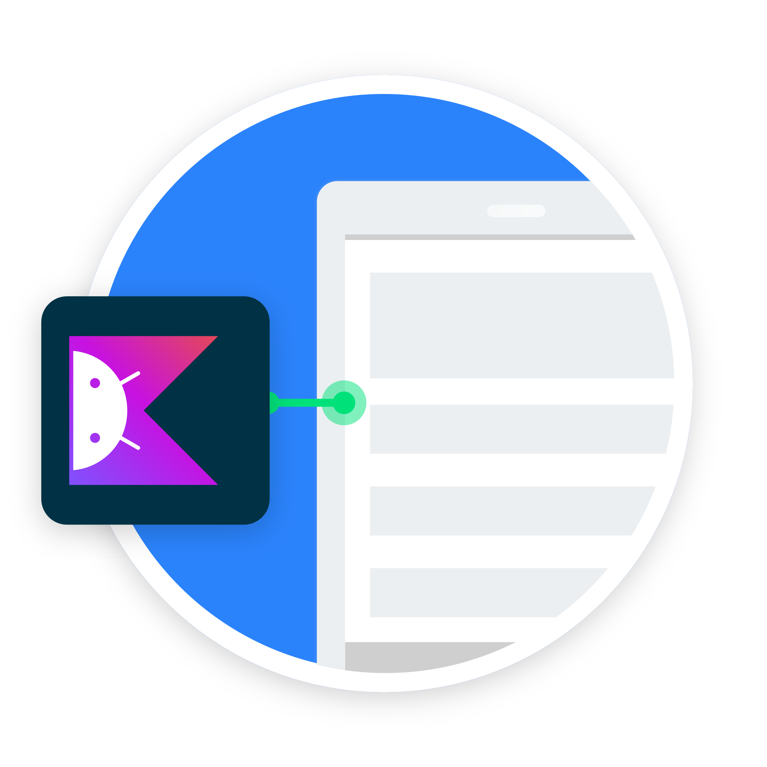
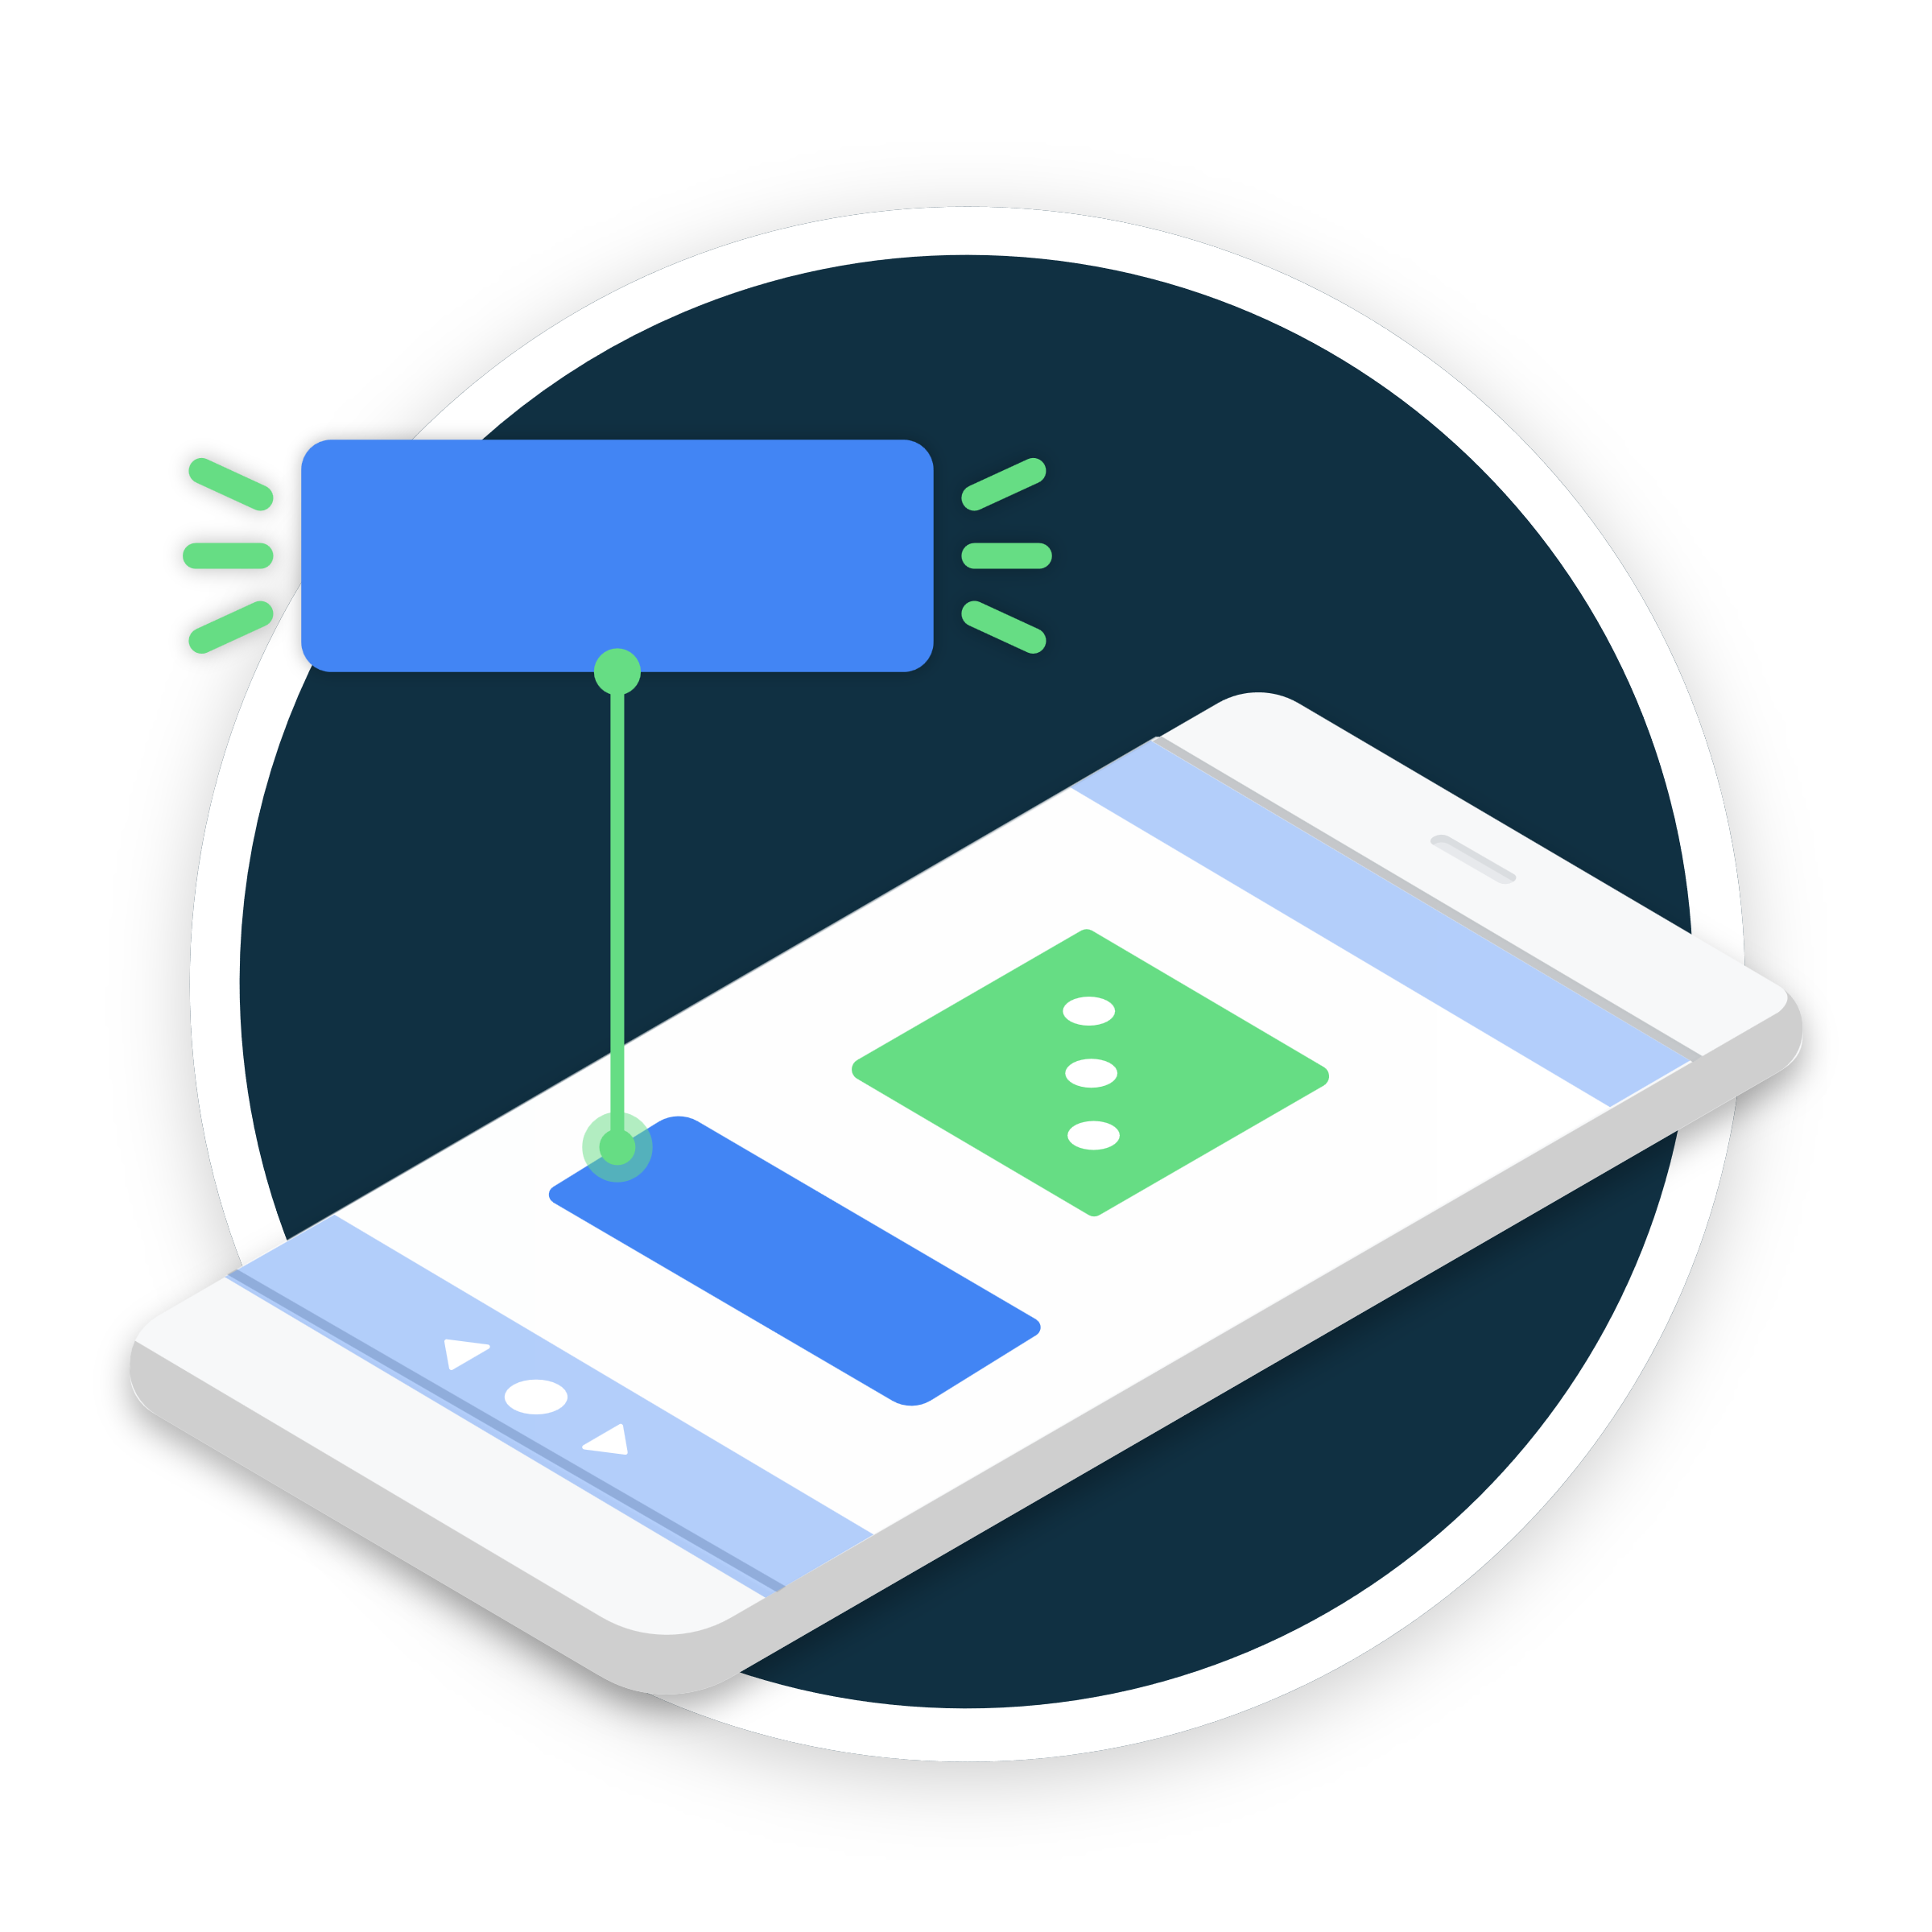
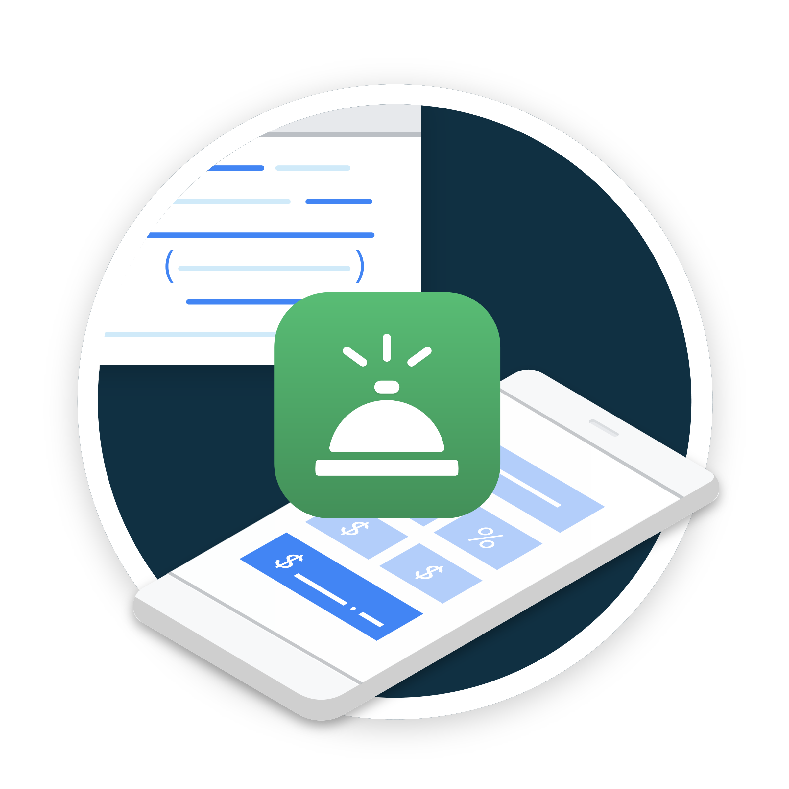

Introduction to Kotlin
Your first Android application
Congratulations on successfully completing Unit 02

Slide 79
Thank you
For attending the Session
see you next time on Day 5

Slide 80
Thank you
For attending the Session
see you next time on Day 5

Slide 81
Thank you
For attending the Session
see you next time on Day 5

Slide 82
Thank you
For attending the Session
see you next time on Day 5

Slide 83
Thank you
For attending the Session
see you next time on Day 5

Slide 84

Thank you
For attending the Session
see you next time on Day 5

